Slide 1
Independent Demand Inventory Management
© Wiley 2007

Slide 2
Types of Inventory
Inventory comes in many shapes and sizes such as
Raw materials – purchased items or extracted materials transformed into components or products
Components – parts or subassemblies used in final product
Work-in-process – items in process throughout the plant
Finished goods – products sold to customers
Distribution inventory – finished goods in the distribution system
© Wiley 2007

Slide 3
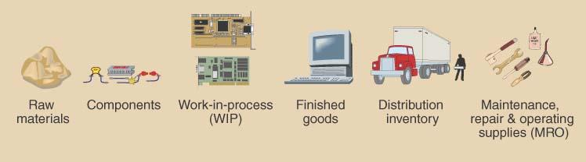
Types of Inventory
© Wiley 2007

Slide 4
Uses of Inventory
Anticipation or seasonal inventory
Fluctuation Inventory or Safety stock: buffer demand fluctuations
Lot-size or cycle stock: take advantage of quantity discounts or purchasing efficiencies
Transportation or Pipeline inventory
Speculative or hedge inventory protects against some future event, e.g. labor strike
Maintenance, repair, and operating (MRO) inventories
© Wiley 2007

Slide 5
Objectives of Inventory Management
Provide desired customer service level
Customer service is the ability to satisfy customer requirements
Percentage of orders shipped on schedule
Percentage of line items shipped on schedule
Percentage of dollar volume shipped on schedule
Idle time due to material and component shortages
© Wiley 2007

Slide 6
Inventory Management Objectives
Provide for cost-efficient operations:
Buffer stock for smooth production flow
Maintain a level work force
Allowing longer production runs & quantity discounts
Minimum inventory investments:
Inventory turnover
Weeks, days, or hours of supply
© Wiley 2007

Slide 7
Customer Service Level Examples
Percentage of Orders Shipped on Schedule
Good measure if orders have similar value. Does not capture value.
If one company represents 50% of your business but only 5% of your orders, 95% on schedule could represent only 50% of value
Percentage of Line Items Shipped on Schedule
Recognizes that not all orders are equal, but does not capture
$ value of orders. More expensive to measure. Ok for finished goods.
A 90% service level might mean shipping 225 items out of the total 250 line items totaled from 20 orders scheduled
Percentage Of Dollar Volume Shipped on Schedule
Recognizes the differences in orders in terms of both line items and
$ value
© Wiley 2007

Slide 8
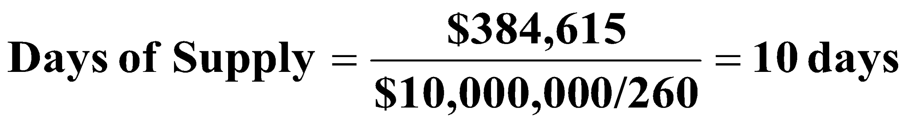
Inventory Investment Measures Example: The Coach Motor Home Company has annual cost of goods sold of $10,000,000. The average inventory value at any point in time is $384,615. Calculate inventory turnover and weeks/days of supply.
Inventory Turnover:
Weeks/Days of Supply:
© Wiley 2007

Slide 9
Relevant Inventory Costs
Item Cost | Includes price paid for the item plus other direct costs associated with the purchase
Holding Costs | Include the variable expenses incurred by the plant related to the volume of inventory held e.g. 15-25%
Capital Costs | The higher of the cost of capital or the opportunity cost for the company
© Wiley 2007

Slide 10
Relevant Inventory Costs
Ordering Cost | Fixed, constant dollar amount incurred for each order placed
Shortage Costs | Loss of customer goodwill, back order handling, and lost sales
Risk costs | Obsolescence, damage, deterioration, theft, insurance and taxes
Storage costs | Included the variable expenses for space, workers, and equipment related to the volume of inventory held
© Wiley 2007

Slide 11
Determining Order Quantities
Lot-for-lot | Order exactly what is needed
Fixed-order quantity | Specifies the number of units to order whenever an order is placed
Min-max system | Places a replenishment order when the on-hand inventory falls below the predetermined minimum level.
Order n periods | Order quantity is determined by total demand for the item for the next n periods
© Wiley 2007

Slide 12
Three Mathematical Models for Determining Order Quantity
Economic Order Quantity (EOQ or Q System)
An optimizing method used for determining order quantity and reorder points
Part of continuous review system which tracks on-hand inventory each time a withdrawal is made
Economic Production Quantity (EPQ)
A model that allows for incremental product delivery
Quantity Discount Model
Modifies the EOQ process to consider cases where quantity discounts are available
© Wiley 2007

Slide 13
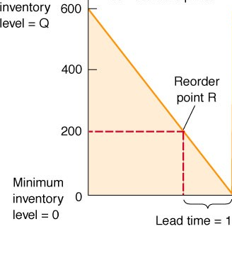
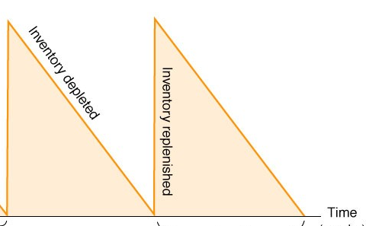
Economic Order Quantity
EOQ Assumptions:
Demand is known & constant - no safety stock is required
Lead time is known & constant
No quantity discounts are available
Ordering (or setup) costs are constant
All demand is satisfied (no shortages)
The order quantity arrives in a single shipment
© Wiley 2007

Slide 14
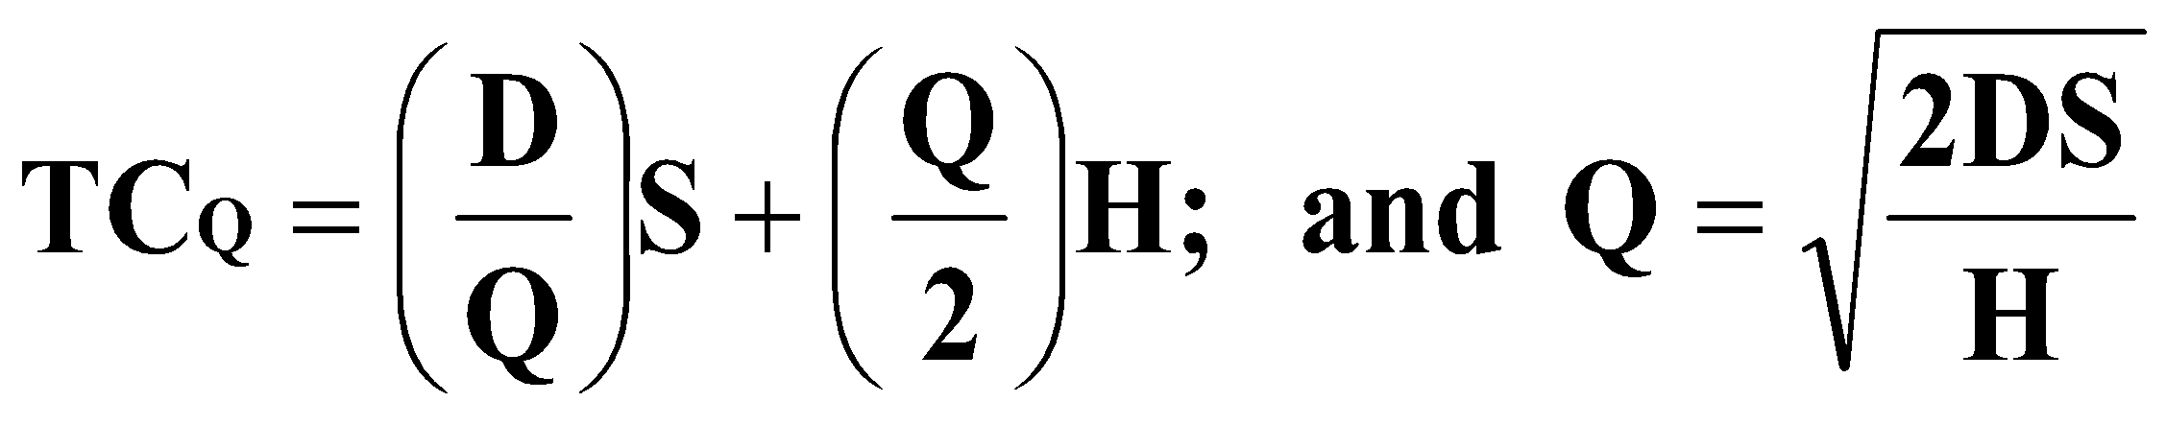
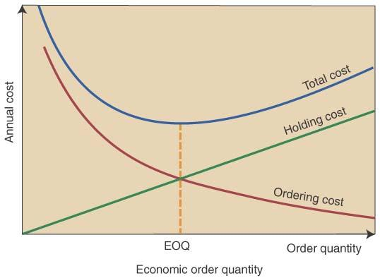
Total Annual Inventory Cost with EOQ Model
Total annual cost= annual ordering cost + annual
holding costs
© Wiley 2007

Slide 15
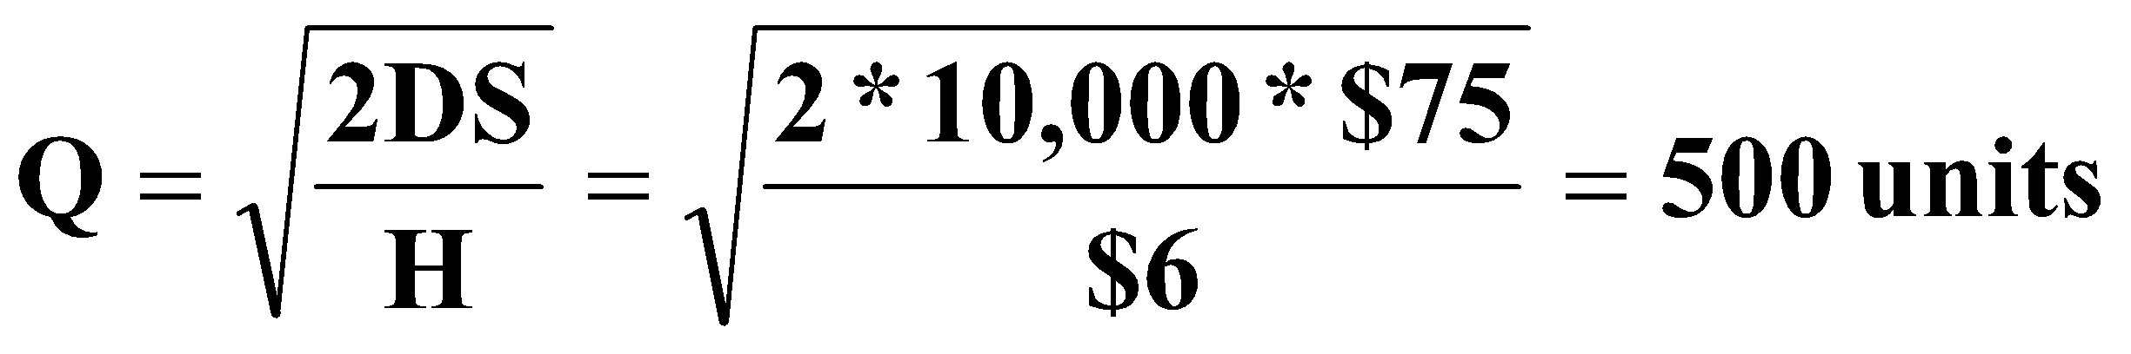
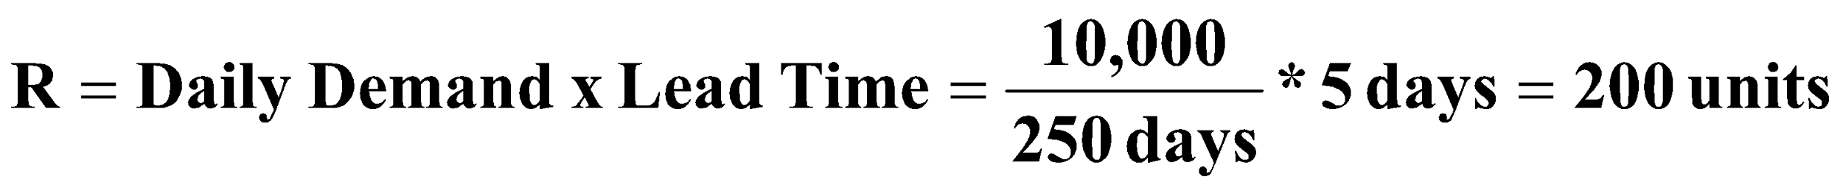
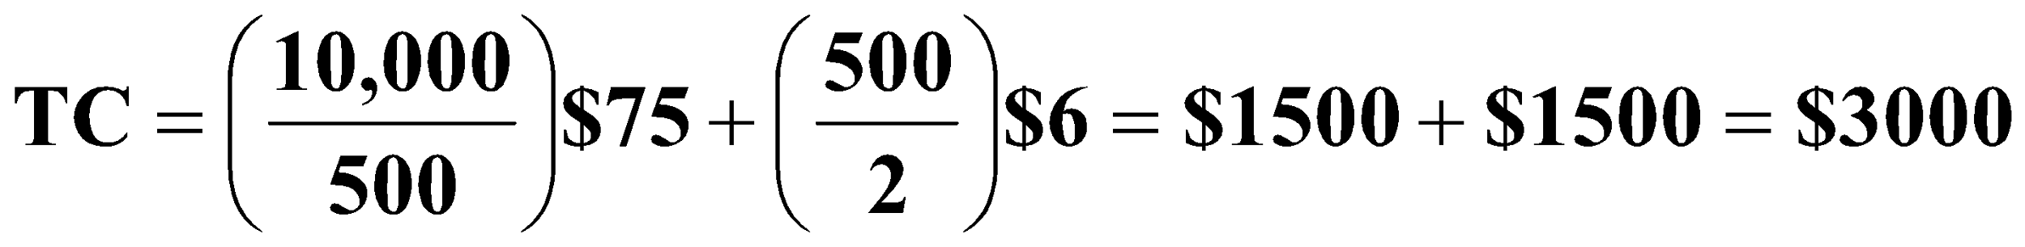
Continuous (Q) Review System Example: A computer company has annual demand of 10,000. They want to determine EOQ for circuit boards which have an annual holding cost (H) of $6 per unit, and an ordering cost (S) of $75. They want to calculate TC and the reorder point (R) if the purchasing lead time is 5 days.
EOQ (Q)
Reorder Point (R)
Total Inventory Cost (TC)
© Wiley 2007

Slide 16
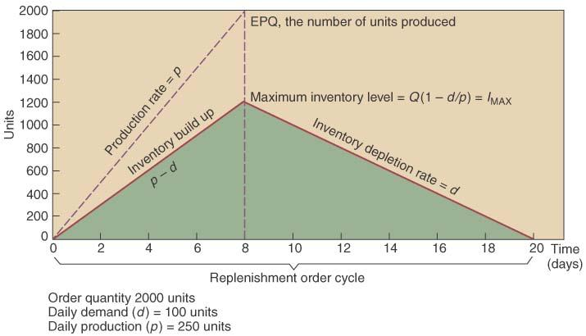
Economic Production Quantity (EPQ)
Same assumptions as the EOQ except: inventory arrives in increments & is drawn down as it arrives
© Wiley 2007

Slide 17
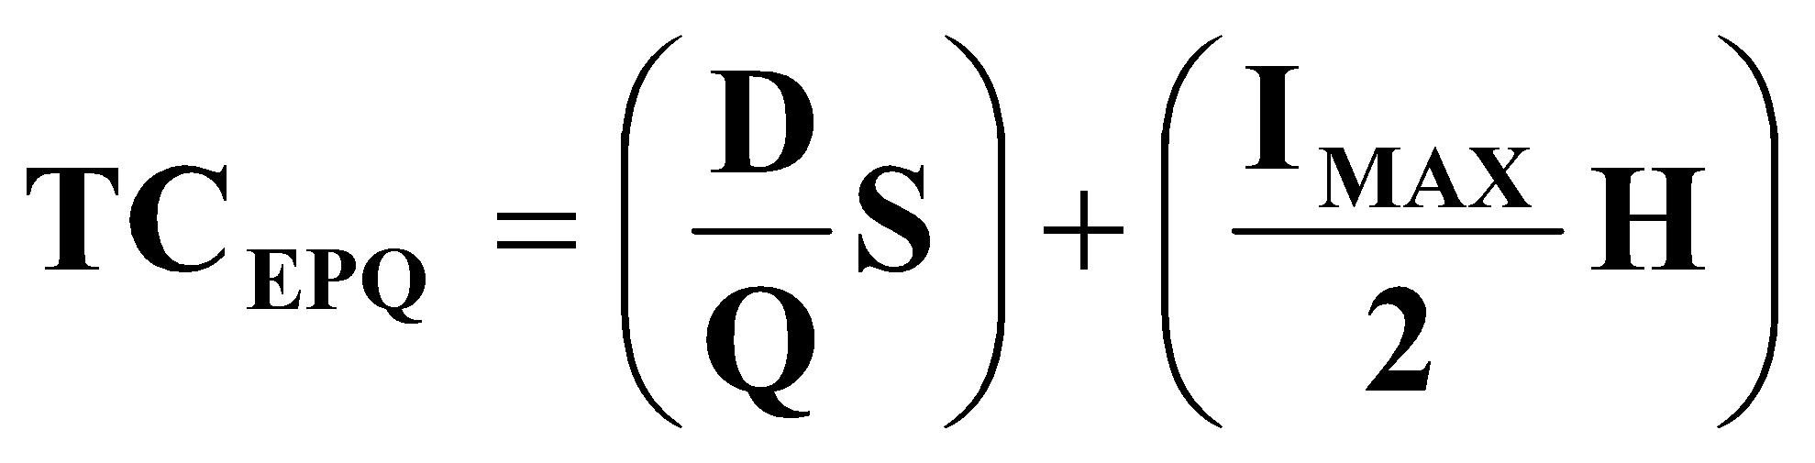
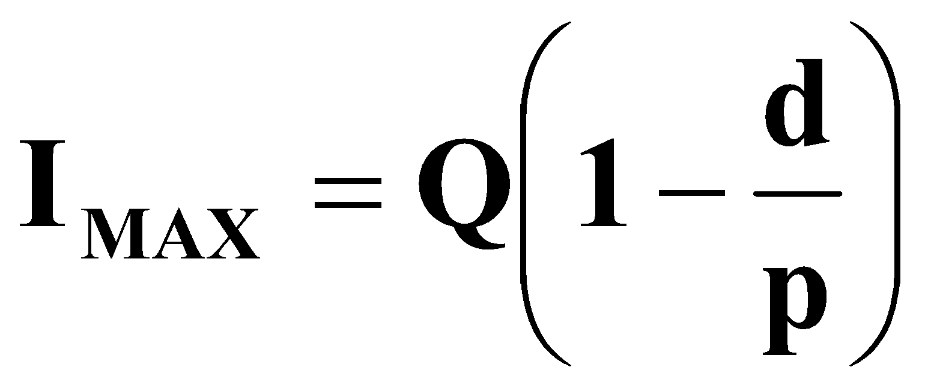
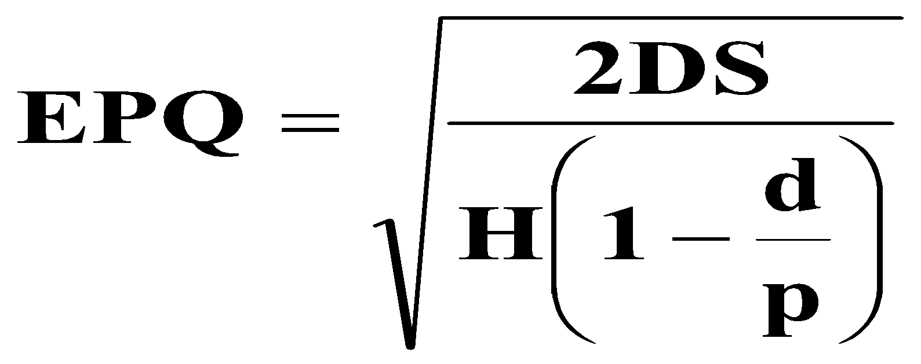
EPQ Equations
Total cost:
Maximum inventory:
d=avg. daily demand rate
p=daily production rate
Calculating EPQ
© Wiley 2007

Slide 18
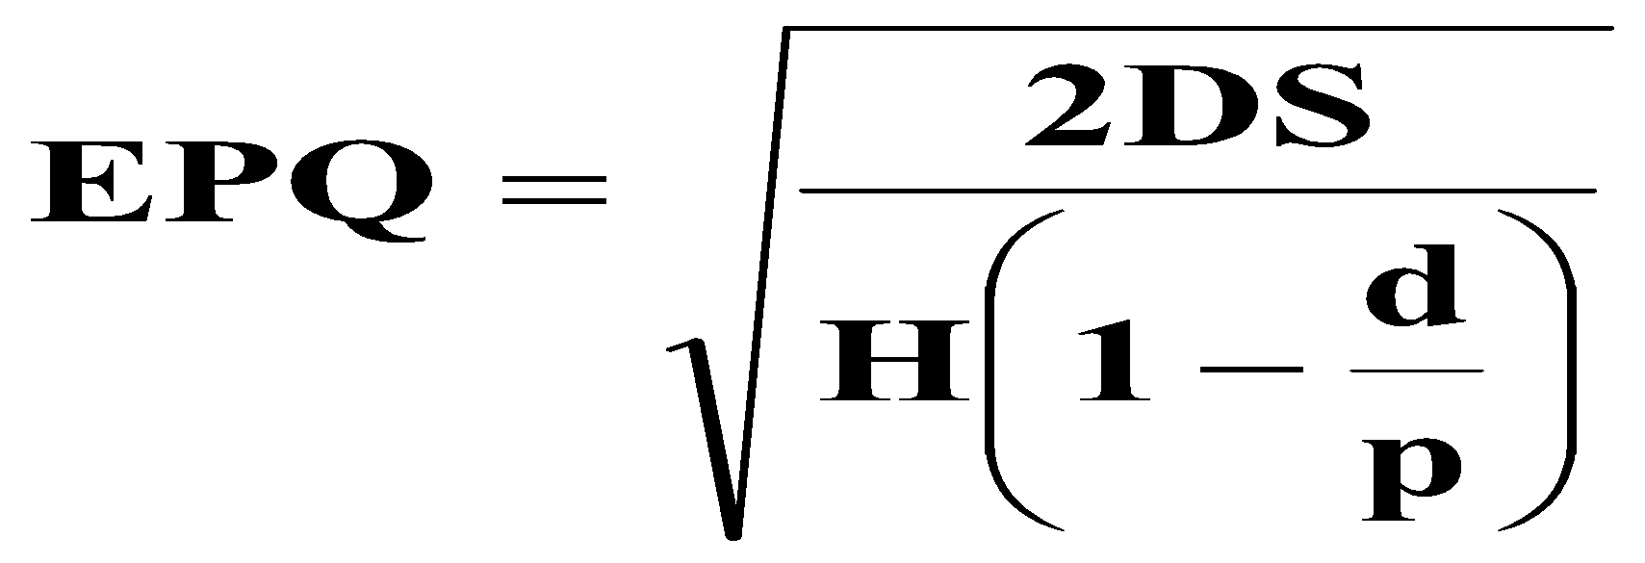
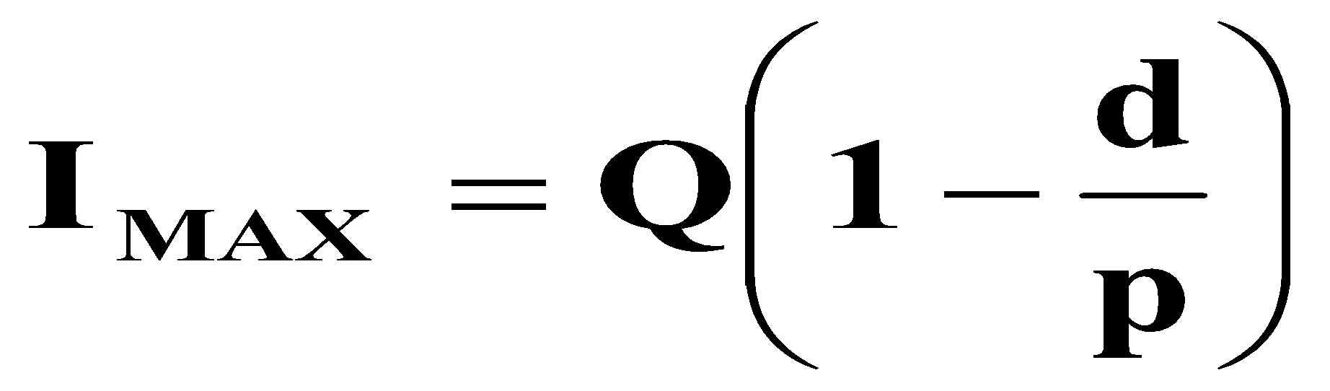
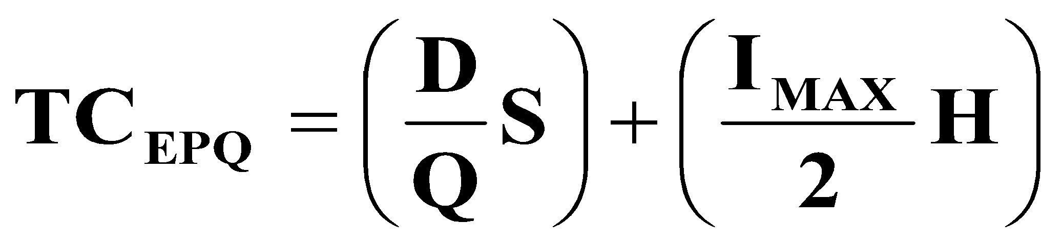
EPQ Problem: HP Ltd. Produces its premium plant food in 50# bags. Demand is 100,000 lbs. per week and they operate 50 wks. each year and HP can produce 250,000 lbs. per week. The setup cost is $200 and the annual holding cost rate is $.55 per bag. Calculate the EPQ. Determine the maximum inventory level. Calculate the total cost of using the EPQ policy.
© Wiley 2007

Slide 19
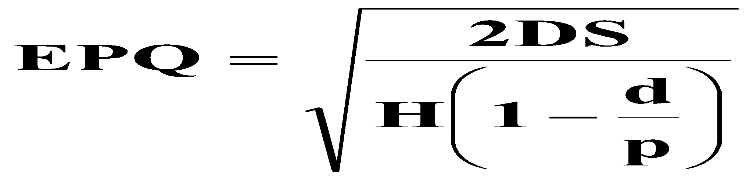
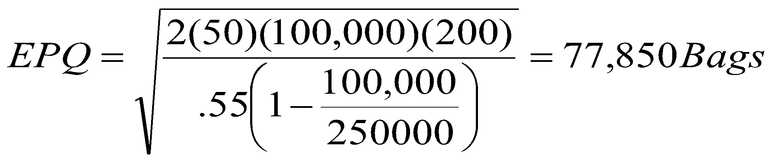
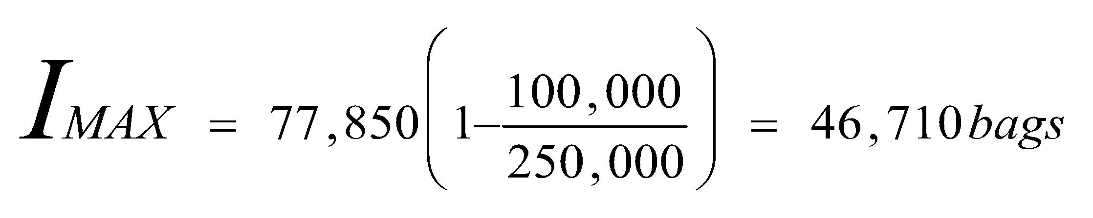
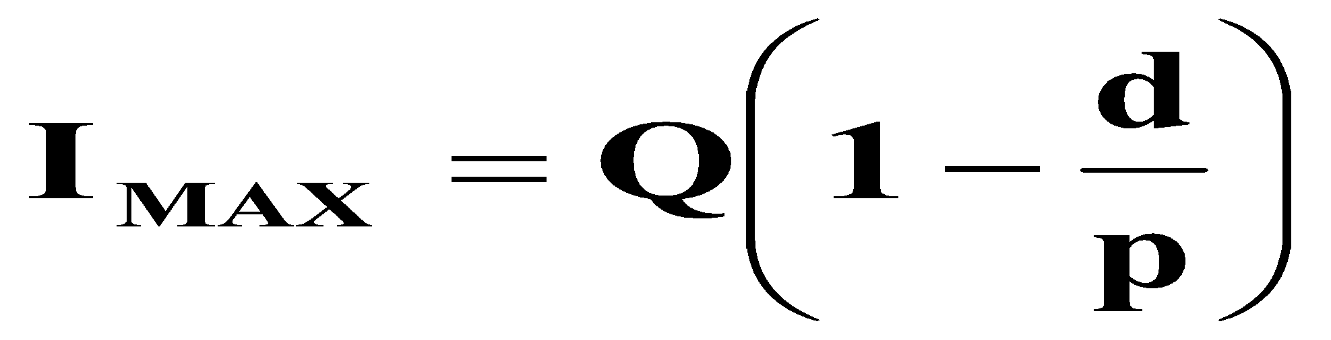
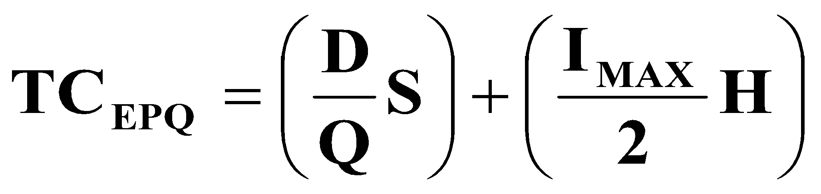
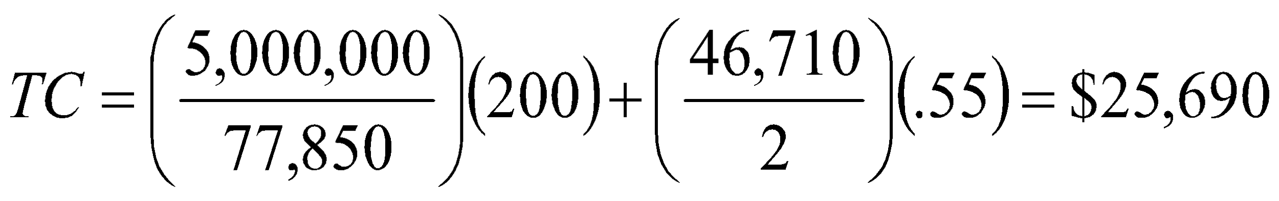
EPQ Problem: HP Ltd. Produces its premium plant food in 50# bags. Demand is 100,000 lbs. per week and they operate 50 wks. each year and HP can produce 250,000 lbs. per week. The setup cost is $200 and the annual holding cost rate is $.55 per bag. Calculate the EPQ. Determine the maximum inventory level. Calculate the total cost of using the EPQ policy.
© Wiley 2007

Slide 20
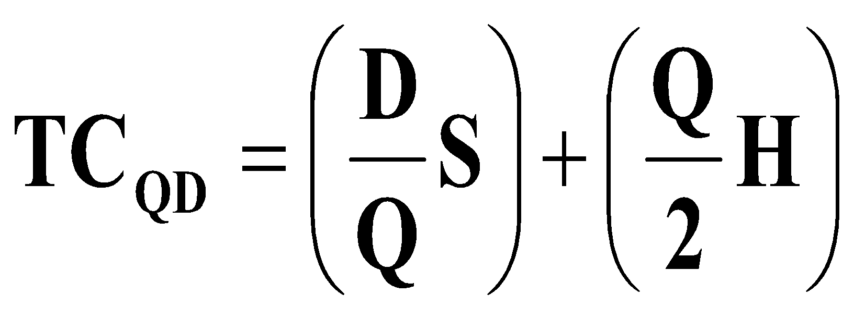
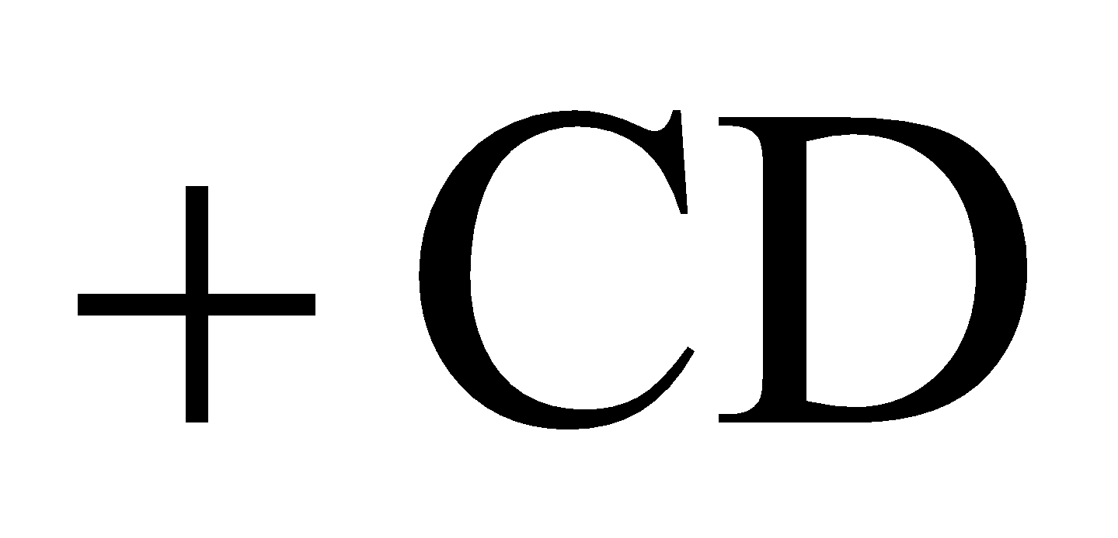
Quantity Discount Model
Same as the EOQ model, except:
Unit price depends upon the quantity ordered
The total cost equation becomes:
© Wiley 2007

Slide 21
Quantity Discount Procedure
Calculate the EOQ at the lowest price
Determine whether the EOQ is feasible at that price
Will the vendor sell that quantity at that price?
If yes, stop – if no, continue
Check the feasibility of EOQ at the next higher price
Continue to the next slide ...
© Wiley 2007

Slide 22
QD Procedure (continued)
Continue until you identify a feasible EOQ
Calculate the total costs (including total item cost) for the feasible EOQ model
Calculate the total costs of buying at the minimum quantity required for each of the cheaper unit prices
Compare the total cost of each option & choose the lowest cost alternative
Any other issues to consider?
© Wiley 2007

Slide 23
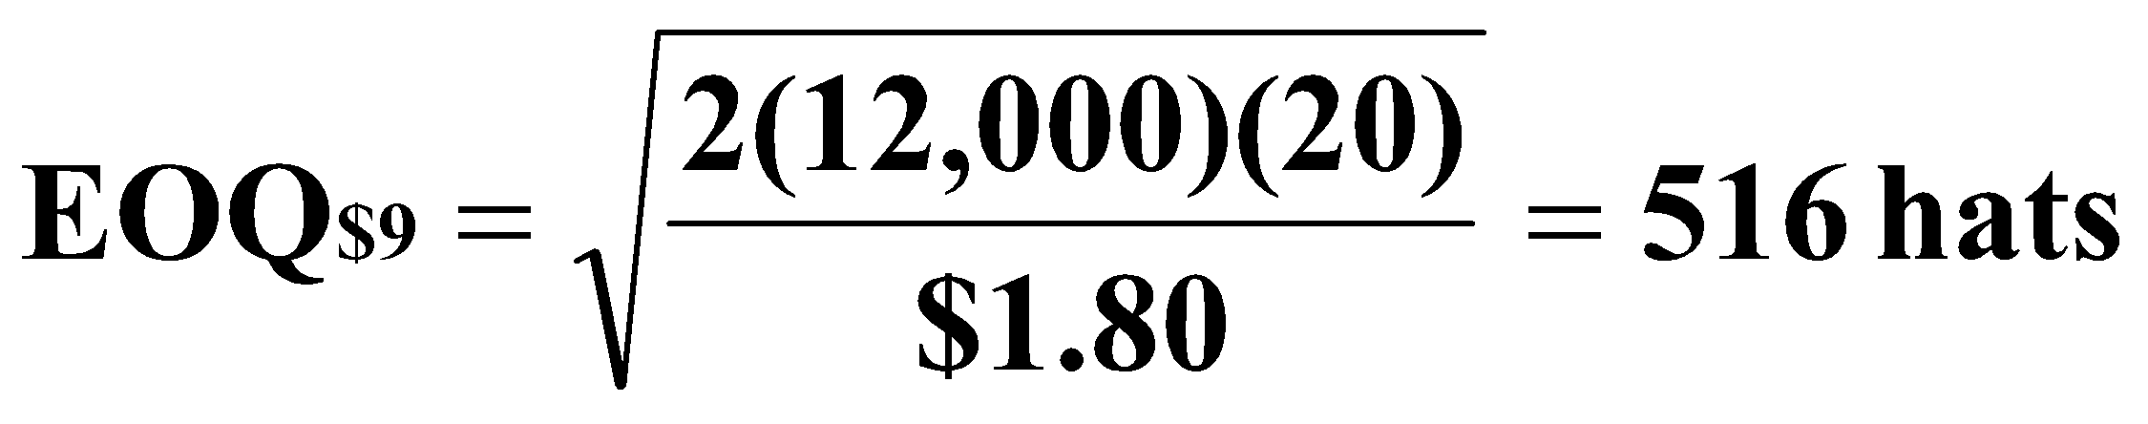
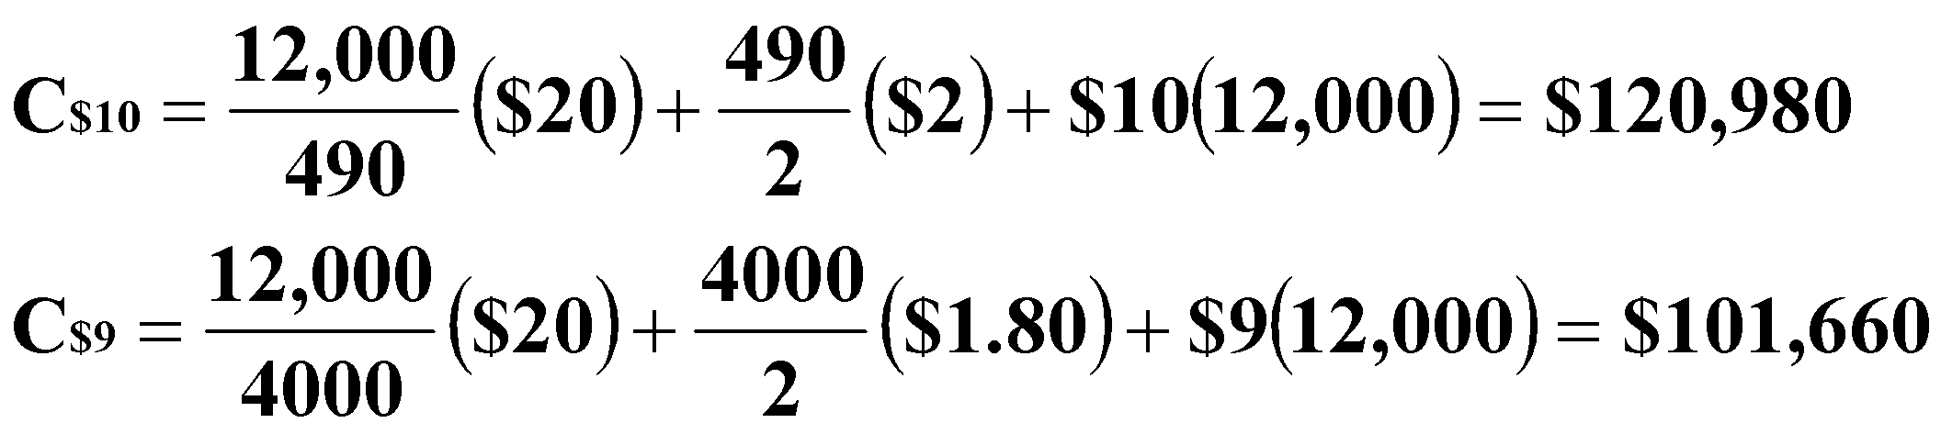
Quantity Discount Example: Collin’s Sport store is considering going to a different hat supplier. The present supplier charges $10 each and requires minimum quantities of 490 hats. The annual demand is 12,000 hats, the ordering cost is $20, and the inventory carrying cost is 20% of the hat cost, a new supplier is offering hats at $9 in lots of 4000. Who should he buy from?
EOQ at lowest price $9. Is it feasible?
Since the EOQ of 516 is not feasible, calculate the total cost (C) for each price to make the decision
4000 hats at $9 each saves $19,320 annually. Space?
© Wiley 2007

Slide 24
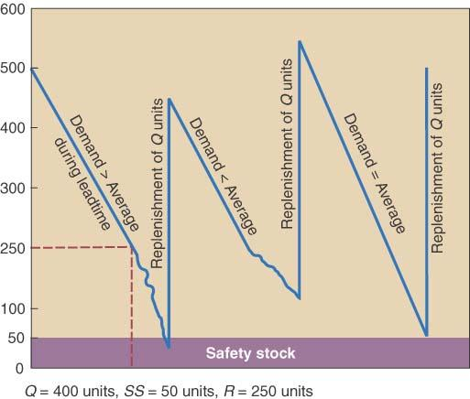
Safety Stock and Service Levels
If demand or lead time is uncertain, safety stock can be added to improve order-cycle service levels
R = dL +SS
Where SS =zσdL, and Z is the number of standard deviations and σdL is standard deviation of the demand during lead time
Order-cycle service level
The probability that demand during lead time will not exceed on-hand inventory
A 95% service level (stockout risk of 5%) has a Z=1.645
© Wiley 2007

Slide 25
Periodic Review Systems
Orders are placed at specified, fixed-time intervals (e.g. every Friday), for a order size (Q) to bring on-hand inventory (OH) up to the target inventory (TI), similar to the min-max system.
Advantages are:
No need for a system to continuously monitor item
Items ordered from the same supplier can be reviewed on the same day saving purchase order costs
Disadvantages:
Replenishment quantities (Q) vary
Order quantities may not quality for quantity discounts
On the average, inventory levels will be higher than Q systems-more stockroom space needed
© Wiley 2007

Slide 26
Periodic Review Systems: Calculations for TI
Targeted Inventory level:
TI = d(RP + L) + SS
d = average period demand
RP = review period (days, wks)
L = lead time (days, wks)
SS = zσRP+L
Replenishment Quantity (Q)=TI-OH
© Wiley 2007

Slide 27
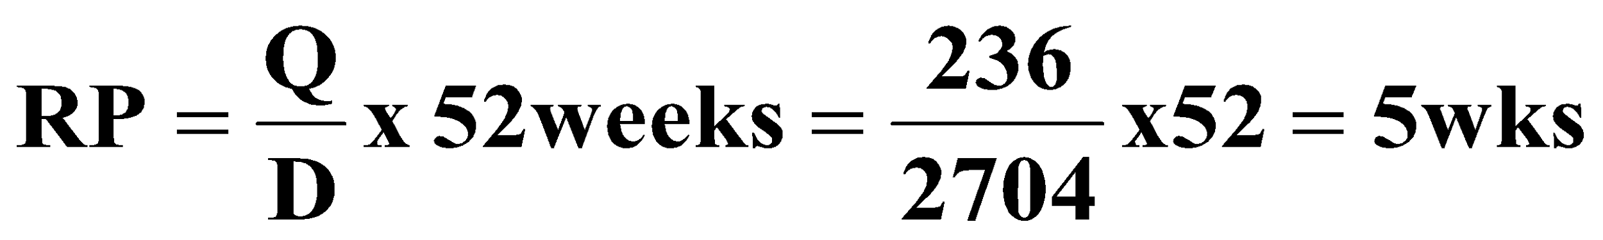
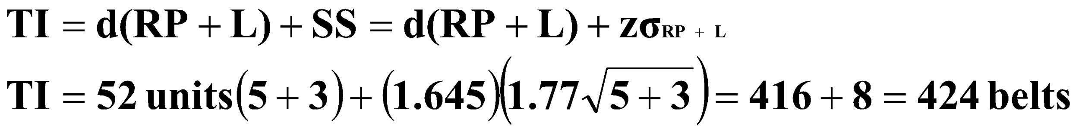

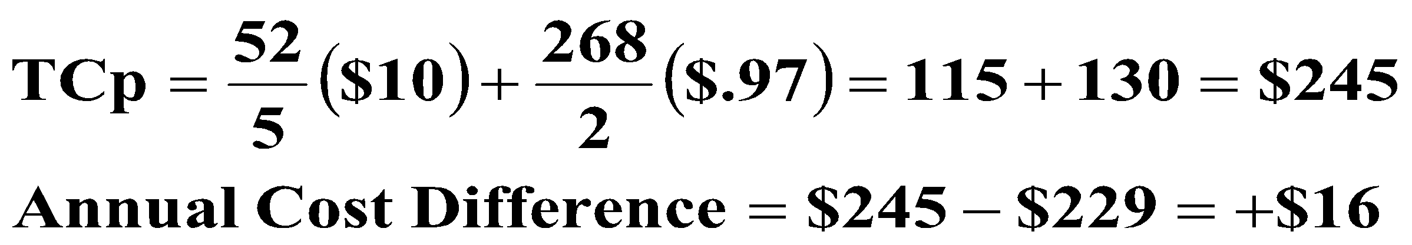
P System: an auto parts store calculated the EOQ for Drive Belts at 236 units and wants to compare the Total Inventory Costs for a Q vs. a P Review System. Annual demand (D) is 2704, avg. weekly demand is 52, weekly σ is 1.77 belts, and lead time is 3 weeks. The annual TC for the Q system is $229; H=$97, S=$10.
Review Period
Target Inventory for 95% Service Level
Average On-Hand
OHavg= TI-dL=424-(52belts)(3wks) = 268 belts
Annual Total Cost (P System)
© Wiley 2007

Slide 28
Single Period Inventory Model
The SPI model is designed for products that share the following characteristics:
Sold at their regular price only during a single-time period
Demand is highly variable but follows a known probability distribution
Salvage value is less than its original cost so money is lost when these products are sold for their salvage value
Objective is to balance the gross profit of the sale of a unit with the cost incurred when a unit is sold after its primary selling period
© Wiley 2007

Slide 29
SPI Model Example: Tee shirts are purchase in multiples of 10 for a charity event for $8 each. When sold during the event the selling price is $20. After the event their salvage value is just $2. From past events the organizers know the probability of selling different quantities of tee shirts within a range from 80 to 120
Payoff Table
Prob. Of Occurrence .20 .25 .30 .15 .10
Customer Demand 80 90 100 110 120
# of Shirts Ordered Profit
80 $960 $960 $960 $960 $960 $960
90 $900 $1080 $1080 $1080 $1080 $1040
Buy 100 $840 $1020 $1200 $1200 $1200 $1083
110 $780 $ 960 $1140 $1320 $1320 $1068
120 $720 $ 900 $1080 $1260 $1440 $1026
Sample calculations:
Payoff (Buy 110)= sell 100($20-$8) –((110-100) x ($8-$2))= $1140
Expected Profit (Buy 100)= ($840 X .20)+($1020 x .25)+($1200 x .30) +
($1200 x .15)+($1200 x .10) = $1083
© Wiley 2007

Slide 30
ABC Inventory Classification
ABC classification is a method for determining level of control and frequency of review of inventory items
A Pareto analysis can be done to segment items into value categories depending on annual dollar volume
A Items – typically 20% of the items accounting for 80% of the inventory value-use Q system
B Items – typically an additional 30% of the items accounting for 15% of the inventory value-use Q or P
C Items – Typically the remaining 50% of the items accounting for only 5% of the inventory value-use P
© Wiley 2007

Slide 31
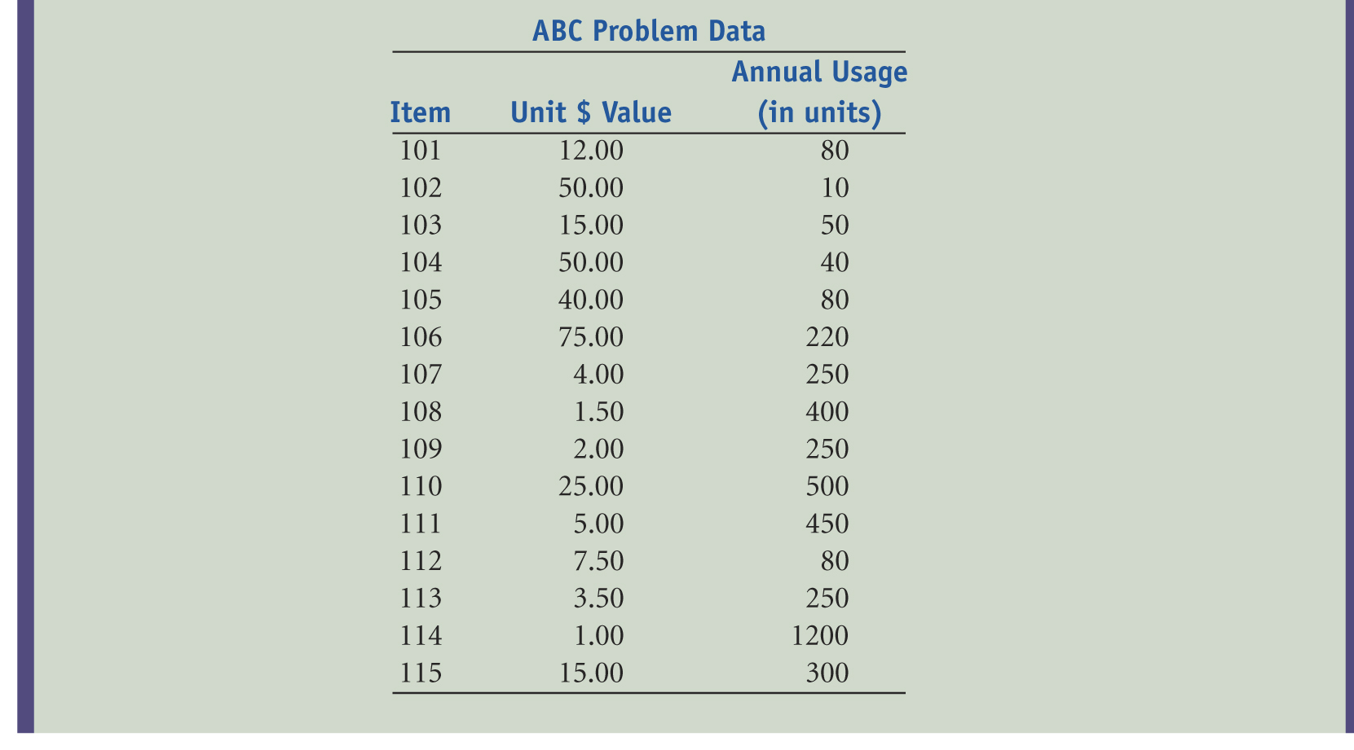
The AAU Corp. is considering doing an ABC analysis on its entire inventory but has decided to test the technique on a small sample of 15 of its SKU’s. The annual usage and unit cost of each item is shown below
© Wiley 2007

Slide 32
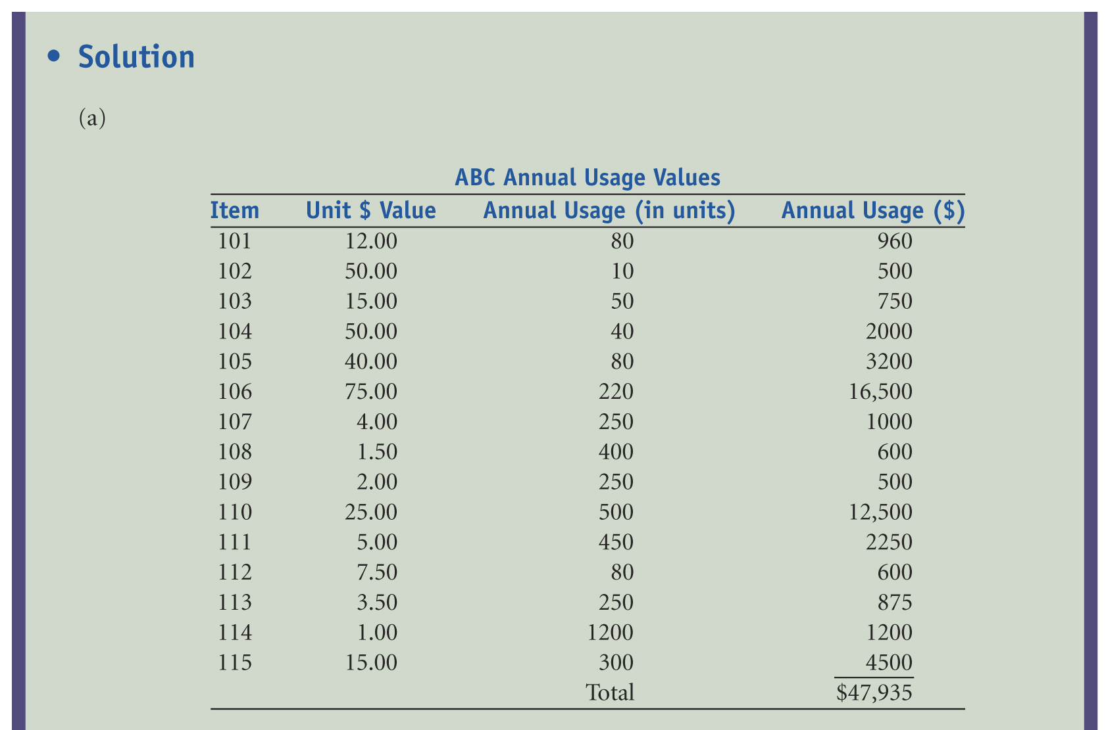
(A) First calculate the annual dollar volume for each item
© Wiley 2007

Slide 33
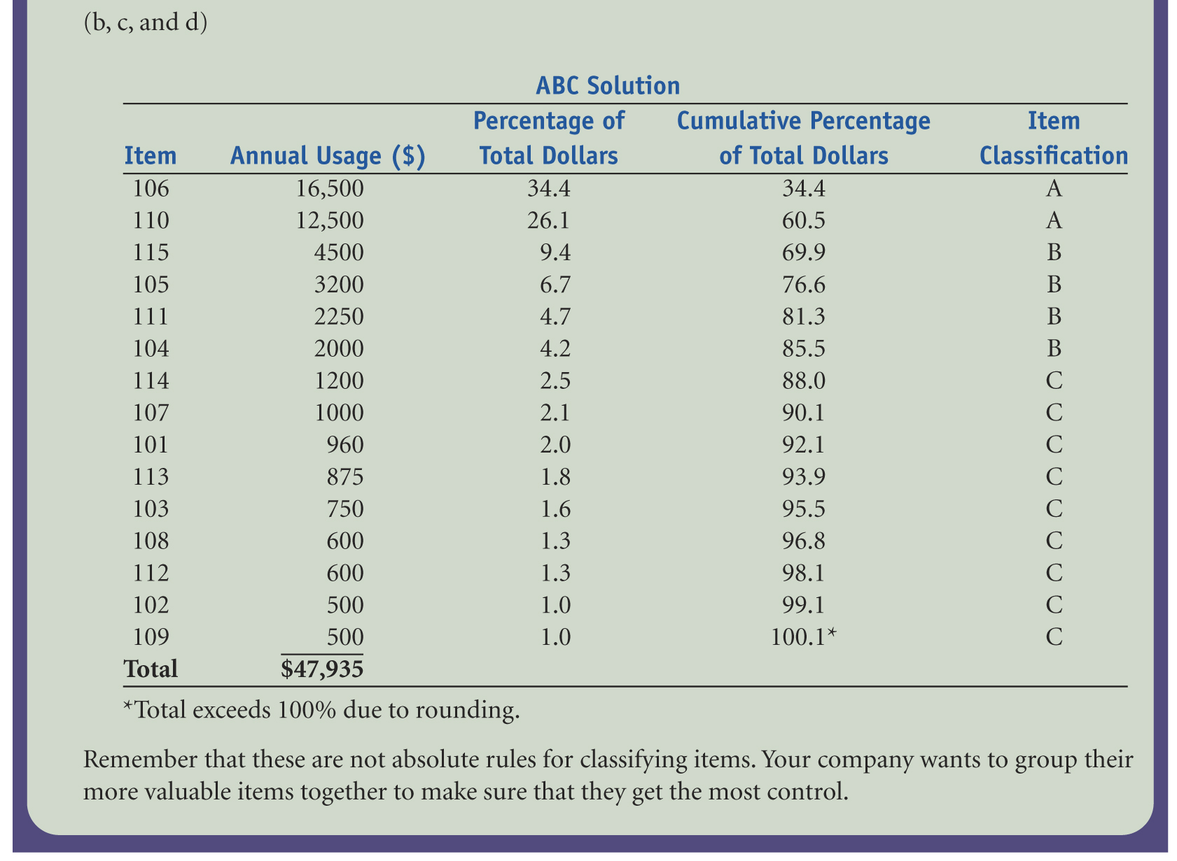
B) List the items in descending order based on annual dollar volume. (C) Calculate the cumulative annual dollar volume as a percentage of total dollars. (D) Classify the items into groups
© Wiley 2007

Slide 34
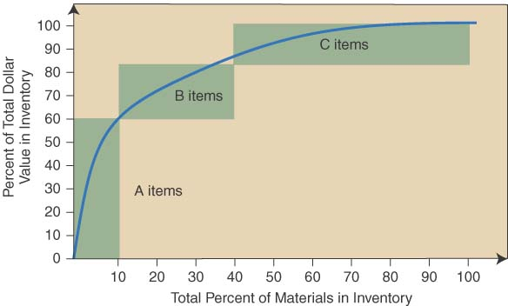
Graphical solution For Example 12.15 showing the ABC classification of materials
The A items (106 and 110) account for 60.5% of the value and 13.3% of the items
The B items (115,105,111,and 104) account for 25% of the value and 26.7% of the items
The C items make up the last 14.5% of the value and 60% of the items
How might you control each item classification? Different ordering rules for each?
© Wiley 2007

Slide 35
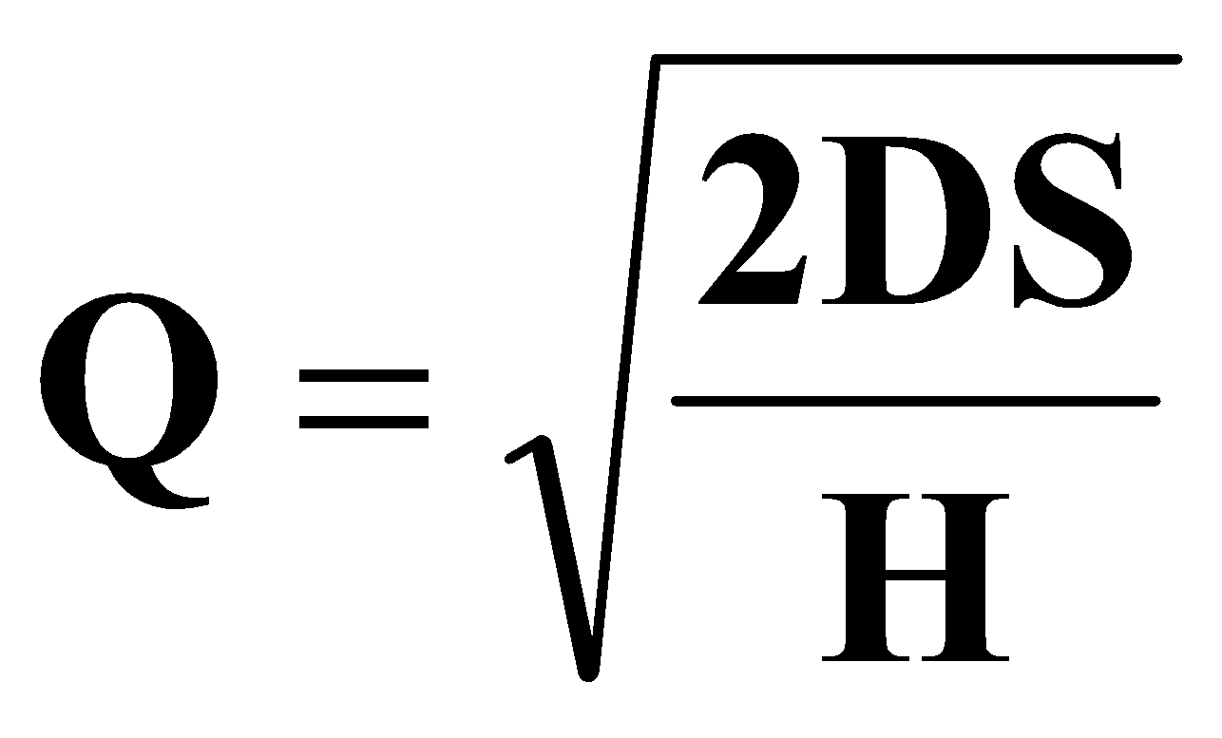
Justifying Smaller Order Quantities
JIT or “Lean Systems” would recommend reducing order quantities to the lowest practical levels
Benefits from reducing Q’s:
Improved customer responsiveness (inventory = Lead time)
Reduced Cycle Inventory
Reduced raw materials and purchased components
Justifying smaller EOQ’s:
Reduce Q’s by reducing setup time (S). “Setup reduction” is a well documented, structured approach to reducing S
© Wiley 2007

Slide 36
Inventory Record Accuracy
Inaccurate inventory records can cause:
Lost sales
Disrupted operations
Poor customer service
Lower productivity
Planning errors and expediting
© Wiley 2007

Slide 37
Inventory Record Accuracy
Two methods are available for checking record accuracy
Periodic counting - physical inventory is taken periodically, usually annually
Cycle counting-daily counting of prespecified items provides the following advantages:
Timely detection and correction of inaccurate records
Elimination of lost production time due to unexpected stock outs
Structured approach using employees trained in cycle counting
© Wiley 2007

Slide 38
Inventory Management Across the Organization
Inventory management policies affect functional areas throughout
Accounting is concerned of the cost implications of inventory
Marketing is concerned as stocking decision affect the level of customer service
Information Systems is involved to tack and control inventory records
© Wiley 2007

